Slide 1


Holistic Communication:
Teaching like Jesus.
God the Communicator
Module 1: Foundations of Orality

Slide 2
What is
ORALITY?
Notes:
Write definition in groups on Manila paper.
Use Forms word cloud for virtual class.

Slide 3
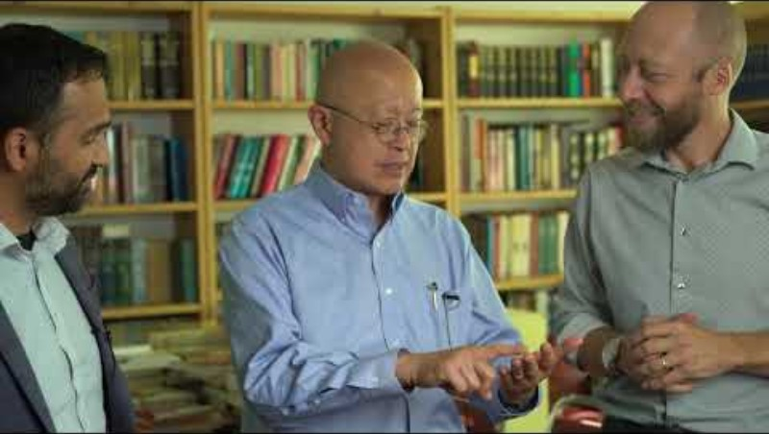

Slide 4
Edit & refine your definition of orality.

Slide 5


When I opened my eyes for the first time, I was blinded by the bright lights shining at my face. All I was able to do was to cry. When my eyes adjusted to the light, I saw three people in blue robes. They wore cold plastic gloves when they held me upside down and cut the line that connected me to another person.
Definition Story

Slide 6
I was still wet when I was wrapped in a soft towel. They laid me down. I felt a warm hand gently caressing me. I felt safe. I stopped crying. Everything was silent. Suddenly I started to hear a rhythmic noise and felt a gentle pulsing movement. It was the familiar heartbeat I already knew for nine months. I was secure again!

Slide 7
I wanted to whisper, “I love you!” But I was not able to move my lips and vocal cords to express my inner speech. All I could do was to hold tide to the person holding me. Although I said nothing, this person understood. She looked into my eyes, smiled, and her eyes started to shine. Receiving this reaction surprised me and I did not know what it meant. All I knew was that it felt so good.

Slide 8
I was so happy that I smiled back. She smiled even harder. I quickly learned that a smile is an expression of joy. It was the first thing I truly understood. Over the next days this exchange of smiles kept happening. Every repetition of our rudimentary but heartfelt and deep communication made new connections in my very malleable brain so that I will remember this for the rest of my life.

Slide 9

Another person, with a much deeper voice, also held me sometimes. I think he loved me also, but he was not as gentle as the first person. Since I was still not able to make noises, except crying when I was hungry, I started an experiment.

Slide 10
Out of the blue, I smiled at him as hard as I possible could. It worked! He smiled back at me. It was the first time that I passed on what I previously learned. I taught him how to smile!
Learning was fun. I wish, this would go on for the rest of my life, but my desire was shattered at the age of almost seven years when grade one started to destroy my preferred learning strategy…
Notes:
With all the new information, rewrite your orality definition in one sentence.

Slide 11




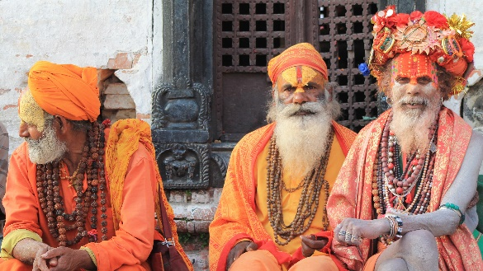
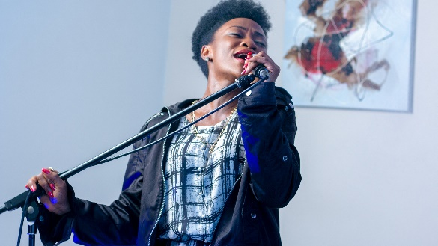
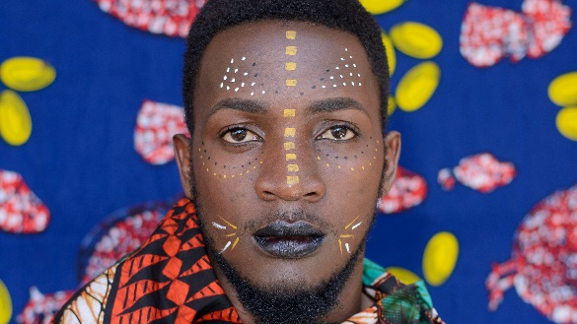
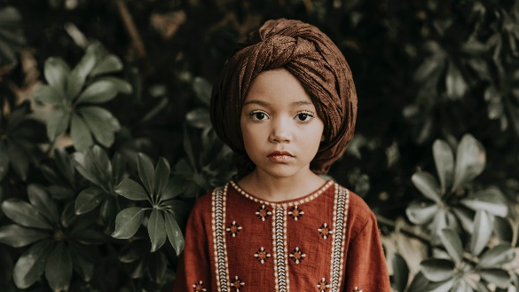


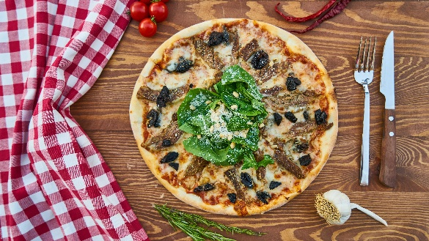









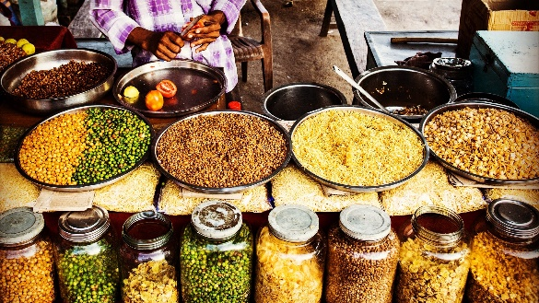


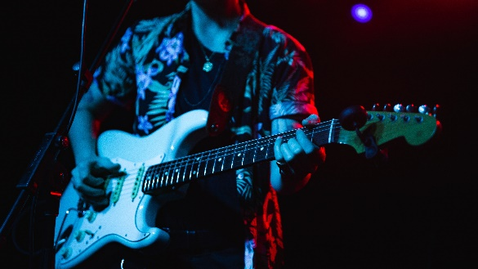

ORALITY
100
%
80
Preference for oral communication
Notes:
Heart language of the Oral Majority.

Slide 12


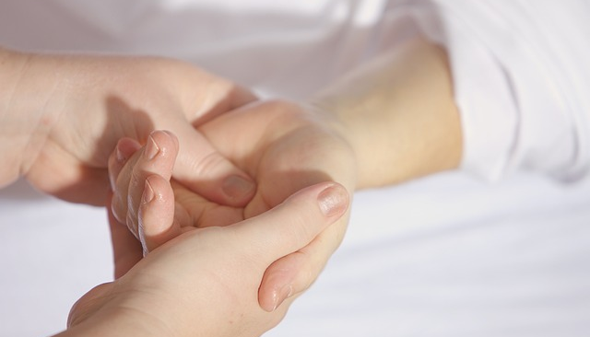
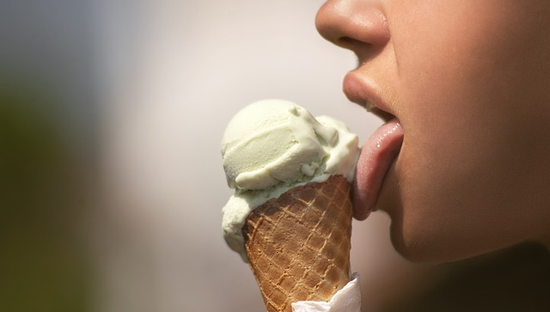

ORALITY
Learned expressions of inner speech
using all senses
to receive, process, remember, and pass on
truth and information.
Notes:
Recite with actions.
Back in the groups: draw a picture, compose a song or poem, or express the definition in another artform.

Slide 13

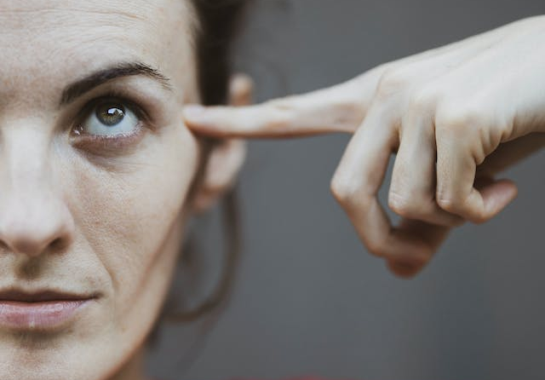
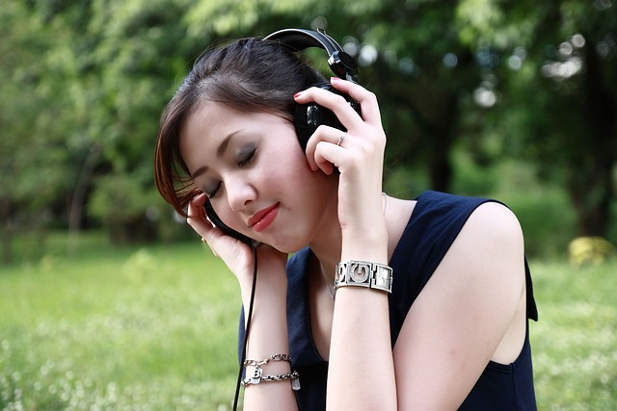

ORALITY
Learned expressions of inner speech
using all senses
to receive, process, remember, and pass on
truth and information.
Notes:
Read Deuteronomy 6:4-9:
How is God using the 5 senses to remind the Israelites to love Him?

Slide 14
ORALITY
Learned expressions of inner speech
using all senses
to receive, process, remember, and pass on
truth and information.
Notes:
Read Deuteronomy 6:4-9:
Where can you find receive, process, remember, and pass on?

Slide 15
ORALITY
=
ILLITERACY
Notes:
Not illiterate

Slide 16
ORALITY
vs.
TEXTUALITY
Notes:
Not vs. Text

Slide 17
ORALITY
Method
Storytelling
Primitive
Left behind
Strategy
Way of learning
Notes:
Myths

Slide 18
Holistic Communication:
Teaching like Jesus.
Module 1: Foundations of Orality
A project of

Slide 19
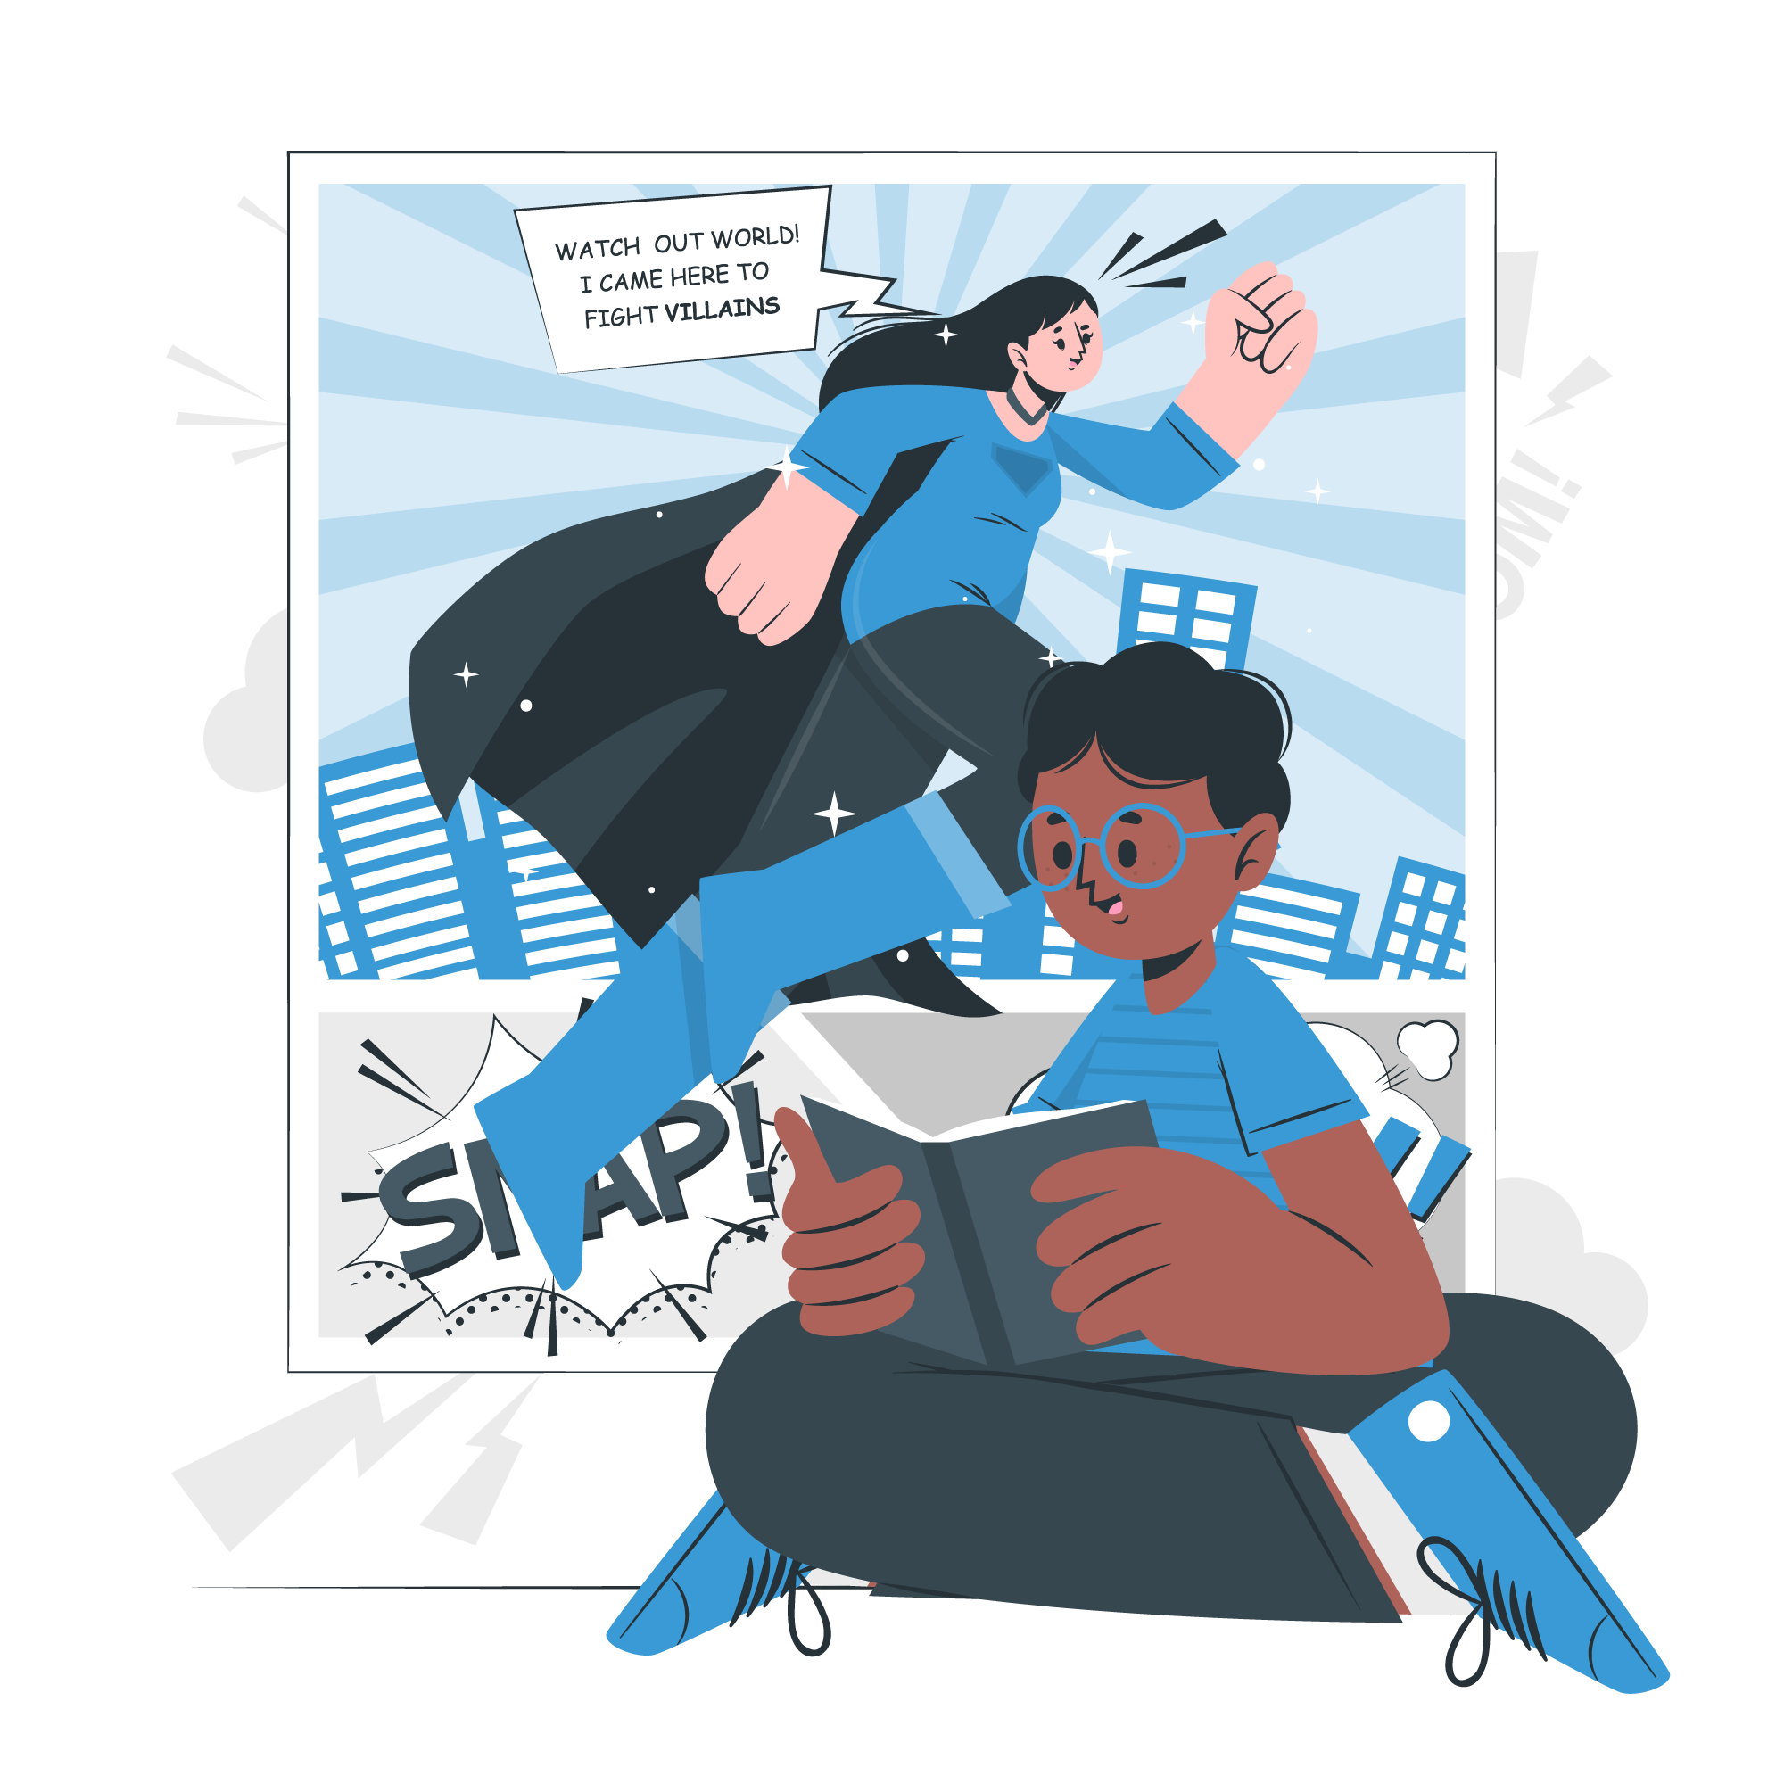
Holistic Communication:
Teaching like Jesus.
Module 2: Narrative
A project of

Slide 20

Holistic Communication:
Teaching like Jesus.
Module 3: Culture & Arts
A project of

Slide 21

Holistic Communication:
Teaching like Jesus.
Module 4: Instructional Design
A project of

Slide 22

Holistic Communication:
Teaching like Jesus.
Application: Integrative Project
A project of

Slide 23
Assignment
Explain orality in such a simple way that it is easy for a 10-year-old to understand. Document it to present it in class.

